Slide 1
Access Control

Slide 2
What Is Access Control?
Granting or denying approval to use specific resources
Information system’s mechanism to allow or restrict access to data or devices
Four standard models
Specific practices used to enforce access control

Slide 3
Access Control Terminology
Identification
  Presenting credentials
  Example: delivery driver presenting employee badge
Authentication
  Checking the credentials
  Example: examining the delivery driver’s badge
Authorization
  Granting permission to take action
  Example: allowing delivery driver to pick up package

Slide 4
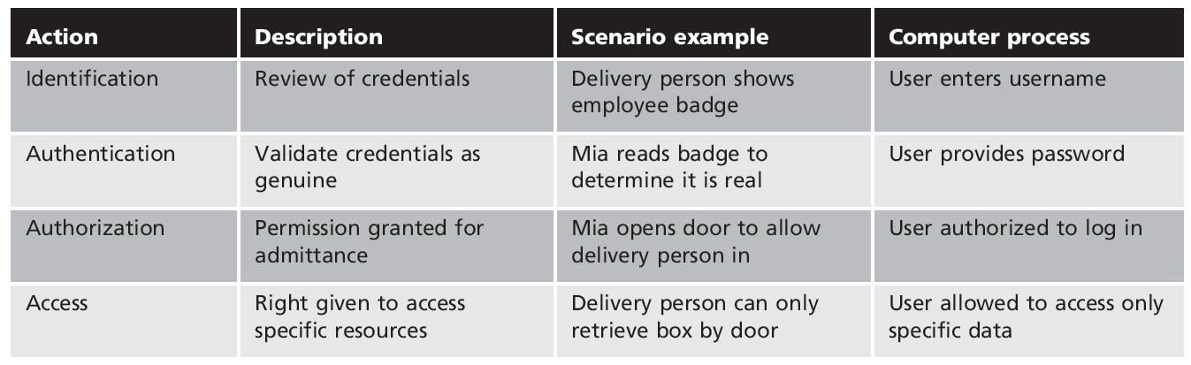
Basic steps in access control

Slide 5
Access Control Terminology (cont’d.)
Object
  Specific resource
  Example: file or hardware device
Subject
  User or process functioning on behalf of a user
  Example: computer user
Operation
  Action taken by the subject over an object
  Example: deleting a file

Slide 6
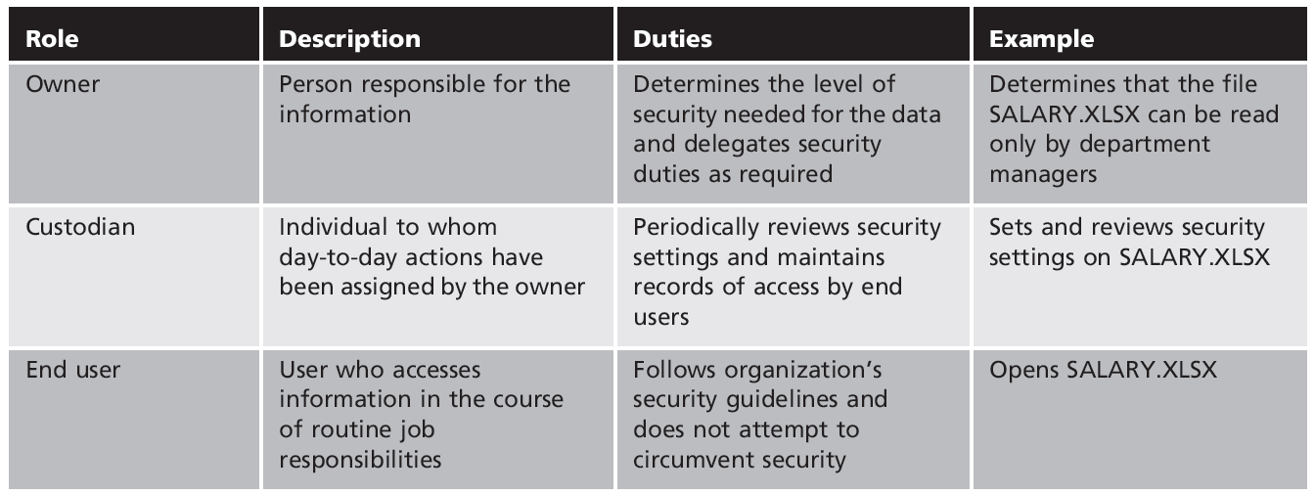
Roles in access control

Slide 7
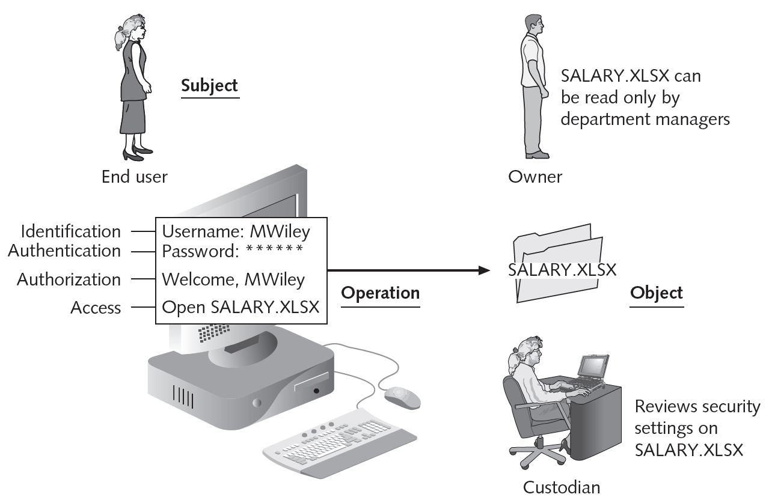
Access control process and terminology

Slide 8
Access Control Models
Standards that provide a predefined framework for hardware or software developers
Used to implement access control in a device or application
Custodians can configure security based on owner’s requirements
Four major access control models

Slide 9
Access Control Models (cont’d.)
Four major access control models (cont’d.)
  Mandatory Access Control (MAC)
  Discretionary Access Control (DAC)
  Role Based Access Control (RBAC)
  Rule Based Access Control (RBAC)

Slide 10
Mandatory Access Control(MAC)
Most restrictive access control model
Typically found in military settings
Two elements
    Labels
    Levels

Slide 11
Mandatory Access Control(MAC)
MAC grants permissions by matching object labels with subject labels
  Labels indicate level of privilege
To determine if file may be opened:
  Compare object and subject labels
  Subject must have equal or greater level than object to be granted access

Slide 12
Discretionary Access Control (DAC)
Discretionary Access Control (DAC)
  Least restrictive model
  Every object has an owner
  Owners have total control over their objects
  Owners can give permissions to other subjects over their objects

Slide 13
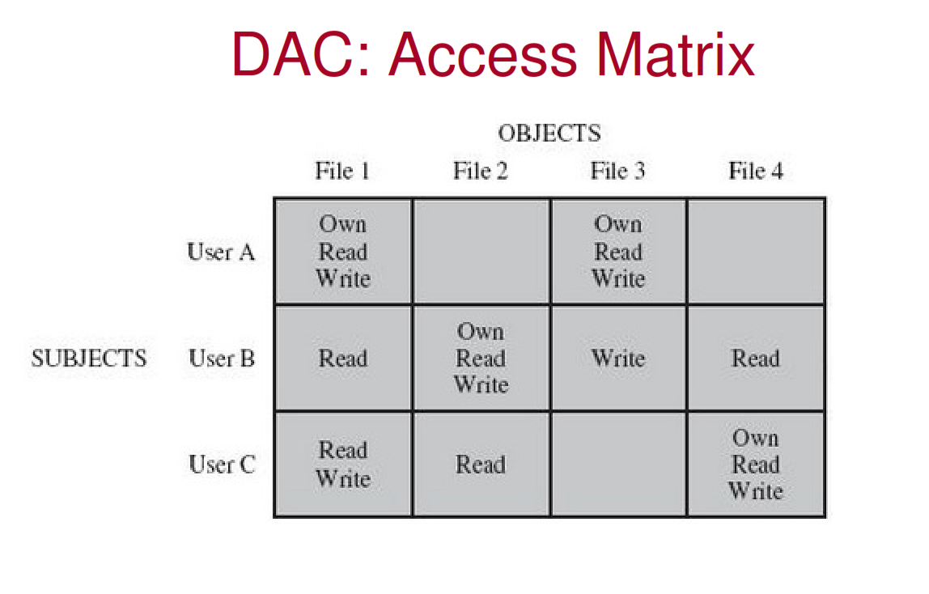


Slide 14
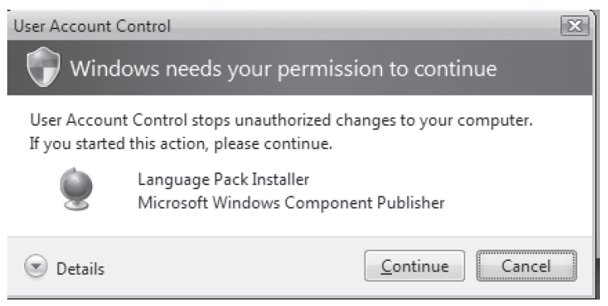
Windows User Account Control (UAC) dialog box

Slide 15
Access Control Models (cont’d.)
Discretionary Access Control (cont’d.)
  Used on operating systems such as most types of UNIX and Microsoft Windows
DAC weaknesses
  Relies on decisions by end user to set proper security level
    Incorrect permissions may be granted
  Subject’s permissions will be “inherited” by any programs the subject executes
  Trojans are a particular problem with DAC

Slide 16
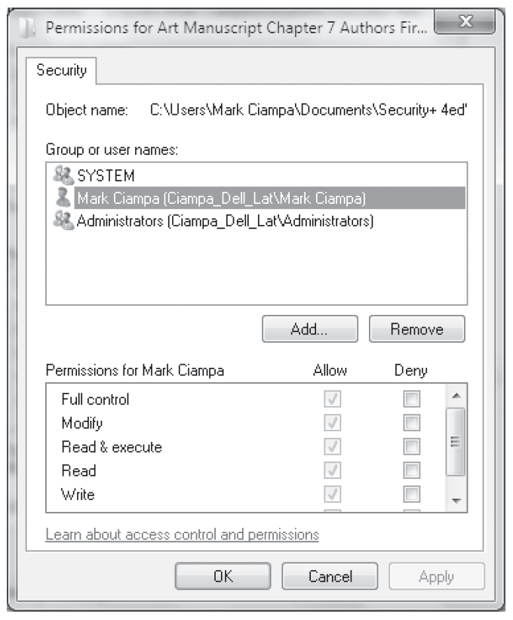
Discretionary Access Control (DAC)

Slide 17
Access Control Models (cont’d.)
Role Based Access Control (RBAC)
  Also called Non-discretionary Access Control
  Access permissions are based on user’s job function
RBAC assigns permissions to particular roles in an organization
  Users are assigned to those roles
Rule Based Access Control (RBAC)
  Dynamically assigns roles to subjects based on a set of rules defined by a custodian

Slide 18
Access Control Models (cont’d.)
Rule Based Access Control (cont’d.)
  Each resource object contains access properties based on the rules
  When user attempts access, system checks object’s rules to determine access permission
  Often used for managing user access to one or more systems
    Business changes may trigger application of the rules specifying access changes

Slide 19
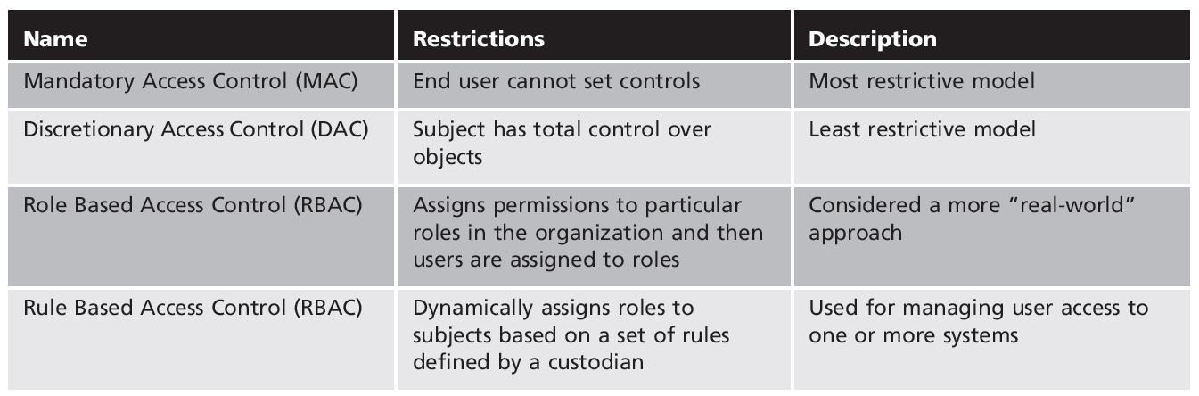
Table 9-3 Access control models

Slide 20
Best Practices for Access Control
Establishing best practices for limiting access
  Can help secure systems and data
Examples of best practices
  Separation of duties
  Job rotation
  Least privilege
  Implicit deny
  Mandatory vacations

Slide 21
Best Practices for Access Control (cont’d.)
Separation of duties
  Fraud can result from single user being trusted with complete control of a process
  Requiring two or more people responsible for functions related to handling money
  System is not vulnerable to actions of a single person
Job rotation
  Individuals periodically moved between job responsibilities

Slide 22
Best Practices for Access Control (cont’d.)
Job rotation (cont’d.)
  Employees can rotate within their department or across departments
Advantages of job rotation
  Limits amount of time individuals are in a position to manipulate security configurations
  Helps expose potential avenues for fraud
    Individuals have different perspectives and may uncover vulnerabilities
  Reduces employee burnout

Slide 23
Best Practices for Access Control (cont’d.)
Least privilege
  Limiting access to information based on what is needed to perform a job function
  Helps reduce attack surface by eliminating unnecessary privileges
  Should apply to users and processes on the system
  Processes should run at minimum security level needed to correctly function
  Temptation to assign higher levels of privilege is great

Slide 24
Best Practices for Access Control (cont’d.)
Implicit deny
  If a condition is not explicitly met, access request is rejected
  Example: network router rejects access to all except conditions matching the rule restrictions
Mandatory vacations
  Limits fraud, because perpetrator must be present daily to hide fraudulent actions
  Audit of employee’s activities usually scheduled during vacation for sensitive positions

